Slide 1
The Traffic Sign Recognition and Training
(TSRT)
Group 2

Slide 2
Team Member
Supervisor: Kiều Trọng Khánh
Mai Văn Tân
Bùi Việt Phong
Hồ Đắc Nghĩa (drop out)
Trần Lê Tuấn (drop out)

Slide 3
Outline:
Scenario Problem
Current solution
Propose our solution
Technology and development environment
Demonstration
Advantages and Disadvantages
Future Plan

Slide 4

Scenario Problem
In Vietnam, we have more than 200 traffic signs
Many traffic signs is not familiar

Slide 5

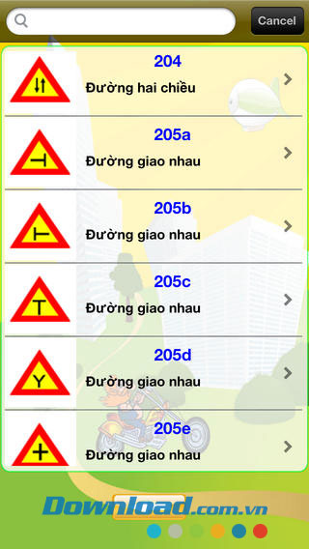

Current solution

Slide 6
Idea
Smart phone has become more affordable and popular.
3G network has developed rapidly in Vietnam with reasonable price.
People should have knowledge about traffic law.

Slide 7



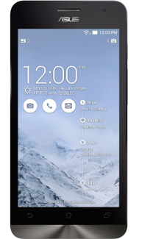
Propose our solution

Slide 8
Features
Recognition
Mobile Application
Sync data
Learning
Training traffic sign

Slide 9
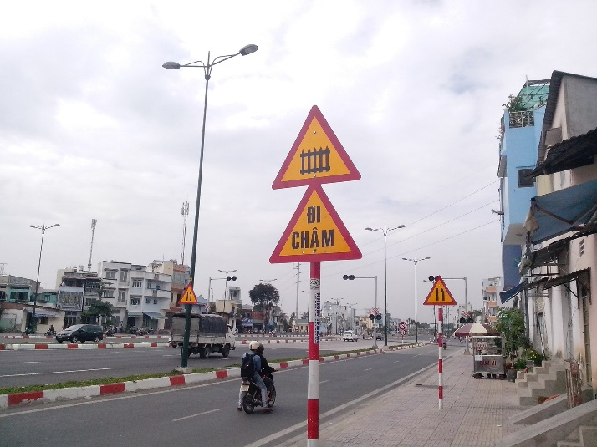
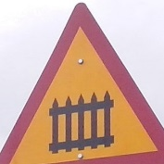
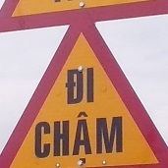

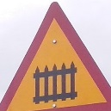

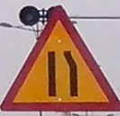
How to detection and recognition work
Image
Detect
Detected Area
Start
Traffic sign
Recognize
Finish
210
245
203c

Slide 10
Definitions
Search auto: search traffic sign using image file or camera.
Train Image: Image use to train the system to recognize traffic sign (The more image to train, the accuracy is higher).
Model: Data result of train process, use to recognize traffic sign.

Slide 11
Demonstration
Search auto in many conditions
Fix wrong recognize
Offline search
Sync favorite
Add new traffic sign

Slide 12

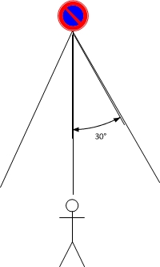

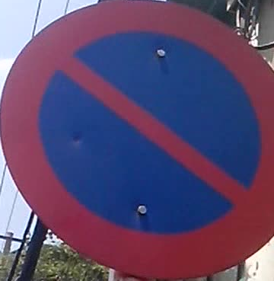

Search auto in many conditions

Slide 13



Fix wrong recognize

Slide 14



Offline search

Slide 15


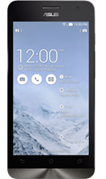
Sync favorite
+

Slide 16
Advantages and Disadvantages
- Automatically
- Support learn
- The accuracy not reach 100%

Slide 17
Future Plan
Support more platform (iOS, Windows phone)
Support more traffic sign types

Slide 18
Technology and development environment

Slide 19
Q&A

Slide 20
Thank you

